Slide 1

Internet Programming
Chapter 3​
Threads
School of Computer and Software, Shenzhen University

Slide 2
Main content
Multithreading and thread pool programming technology多线程和线程池编程技术
Executor concurrent programming framework执行器并发编程框架
Concurrent program structure design 并发程序结构设计
File compression concurrent programming example文件压缩并发编程示例
Synchronous block programming techniques and examples同步块编程
Connection thread programming techniques and examples连接编程

Slide 3
Proper application of multithreaded programming technology
Advantages: Network programs, especially I/O -limited or CPU -limited network programs, introduce multithreading to improve concurrency and program performance.
Disadvantages: The creation, switching, and cleanup of threads themselves consume performance resources and have a negative impact on program performance.
Reasonable degree: The number of threads is moderate. Once you have created enough threads to use all the available idle time on the computer, creating more threads will only waste MIPS and memory on thread management.

Slide 4
Disadvantages of traditional multithreading
Traditional multithreading method: using the new Thread(...).start() method
question:
( 1 ) High overhead.开销高 For the JVM , each time a new thread is created or destroyed, it will incur a lot of overhead. The machine's MIPS and memory are wasted on thread management.
( 2 ) Lack of thread management. There is no pool to limit the number of threads. If the concurrency is high, many threads will be created, and there may be competition between threads, which will occupy too many system resources and increase the consumption of system resources. Moreover, if the number of threads exceeds the system load, it is easy to cause system instability.

Slide 5
Java multithreaded concurrent programming framework
JDK 1.5 and above, java.util.concurrent.* provides an Executor framework to encapsulate and hide the details of multi-threaded asynchronous control, making callbacks easier to handle.
Executor framework (concurrent programming framework): refers to the functional classes related to Executor in the JDK concurrency library , including thread pool, Executor , Executors , ExecutorService , Future , Callable , etc.
Programmers can create multiple different threads and get the required answers in the desired order.

Slide 6
Thread Pool​
Function: When you need to limit the number of threads running at the same time in an application, you can use thread pool programming. The function of the thread pool is to limit the number of threads executing in the system.
Principle : Submit concurrently executed tasks to a thread pool (no need to start a new thread for each concurrently executed task). Once there is an idle thread in the pool, a thread will be assigned to the task for execution. Inside the thread pool, tasks are inserted into a blocking queue , and threads in the thread pool will take tasks from this queue. When a new task is inserted into the queue, an idle thread will successfully take the task from the queue and execute it.
The basic idea of thread pool is that it is an object pool idea, which opens up a piece of memory space to store many ( not dead ) threads. The thread execution scheduling in the pool is handled by the pool manager. When there is a thread task, one is taken from the pool, and the thread object is returned to the pool after execution. This can avoid the performance overhead caused by repeated creation of thread objects and save system resources.
Thread pools are often used in programming implementations of multi-threaded servers. Each connection that reaches the server through the network is packaged as a task and submitted to the thread pool. The threads in the thread pool will process requests on the connection concurrently.
Java5 and above support thread pool programming

Slide 7
Advantages of the thread pool approach
Reuse threads. By reusing the created threads, the overhead of thread creation and destruction is reduced. Each working thread can be reused to perform multiple tasks.
Effectively control the number of concurrent threads: You can adjust the number of working threads in the thread pool according to the system's capacity to prevent the server from being overwhelmed by excessive memory consumption ( each thread requires about 1MB of memory. The more threads you open, the more memory is consumed, and eventually the server crashes ) .
It provides simpler and more flexible thread management. It can provide various thread usage functions such as scheduled execution, periodic execution, single thread, variable number of threads, etc.

Slide 8
Executor framework
Relationship between
In the Executor framework, Executor is used to manage Thread objects, thus simplifying concurrent programming.
The main difference between CompletionService and ExecutorService is that the submitted tasks are not necessarily completed in the order in which they are added to the list they maintain. Its implementation is to maintain a BlockingQueue that saves Future objects . Only when the status of the Future object is completed will it be added to the Queue .
(3) The Executor interface separates task submission from task execution and defines a method called execute that receives a Runnable object . It is the most basic interface in the Executor framework, similar to the Collection interface in a collection .
(4) ExecutorService is a subclass interface of Executor , which defines methods ( API ) for operating Executor , such as terminating tasks, submitting tasks, and tracking task return results . After an ExecutorService is closed, the thread pool will no longer receive any tasks. For ExecutorService that is no longer used , it should be closed to release resources. It is the implementation of the thread pool.
(1) The Callable interface is similar to Runnable and is designed for classes whose instances may be executed by another thread. Provide a call() method as the thread's execution body. The call() method is more powerful than the run() method: it has a return value and can throw exceptions.
When you submit a Callable object to the thread pool, you will get a Future object, and it has the same generic type as the Callable instance you passed in.
(5) The Executors class is mainly used to provide thread pool related operations. It provides a series of factory methods for creating thread pools. The returned thread pools all implement the ExecutorService interface .
(2) The Future interface is used to cancel the execution result of a specific Runnable or Callable task, check whether it is completed, and obtain the result. If necessary, the execution result can be obtained through the get() method. The get() method will block until the task returns the result.

Slide 9
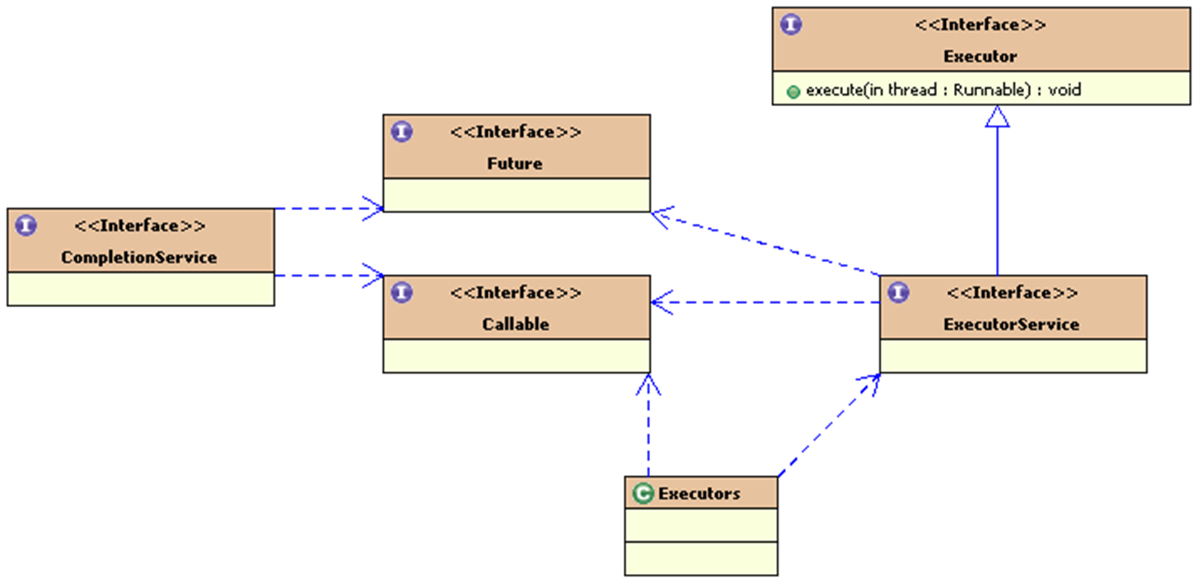

Slide 10
Asynchronous computing program structure design model
In multi-threaded programming, it is troublesome for the main thread to obtain the results of the worker thread (asynchronous computing thread). It is necessary to design a special program structure, which is cumbersome and error-prone. Use Future in the Executor framework to track the results of asynchronous computing and design a good asynchronous computing program structure model.
According to the idea of divide and conquer, asynchronous computing threads are divided into three categories according to their responsibilities:
(1) The initiating thread of asynchronous computing (control thread) : It is responsible for decomposing and initiating asynchronous computing tasks, and assigning the decomposed tasks to the worker thread of asynchronous computing for execution. After initiating asynchronous computing, the initiating thread can obtain the collection of Futures , so as to track the results of asynchronous computing.
(2) Asynchronous computing work thread : responsible for specific computing tasks
(3) Asynchronous calculation result collection thread : obtains the Future collection from the initiating thread, is responsible for monitoring the status of Future , and processes the results of asynchronous calculation according to the status of
Thread of Control
Work thread
Calculation result collection thread

Slide 11
Asynchronous computing program structure example
Application example: Use Executor framework multithreaded programming to find the maximum value in a large array of numbers. P72-73
Ch3.FindMaxInteger.FindMaxTask.java
Ch3.FindMaxInteger.MultithreadedMaxFinder.java
ch3.FindMaxInteger.StartClass.java
Mainly use Future , Callable and Executor classes

Slide 12
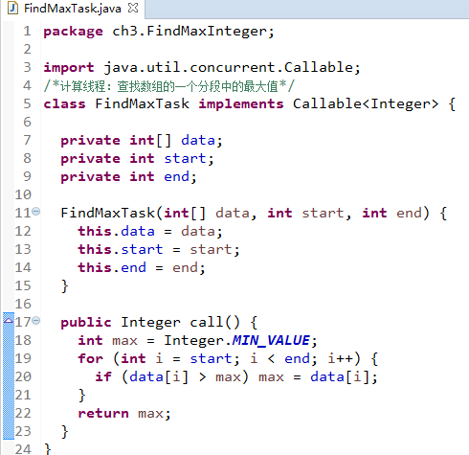
FindMaxTask.java

Slide 13
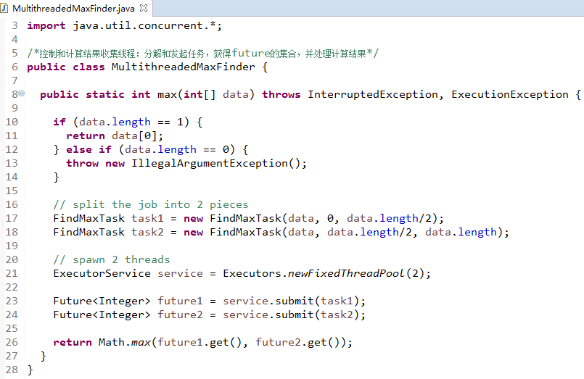
MultithreadedMaxFinder.java

Slide 14
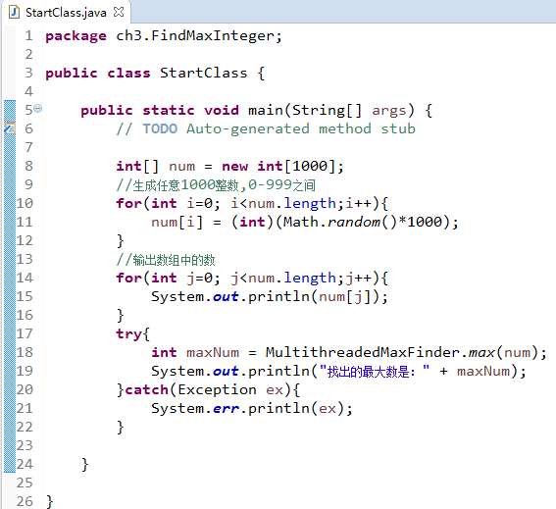
StartClass.java

Slide 15
Programming application problem scenario : compressed files
gzip compression
Application features: large number of I/O operations
Application characteristics: Data compression is a highly
Don't run too many threads at the same time
Programming with thread pools

Slide 16
Using thread pool to implement compressed file programming
Demonstration running sample code:
Ch3.threadPool.GZipAllFiles.java, GZipRunnable.java
Explain the program structure
Programming Ideas
Main program:
List the files in a directory and determine which file to compress
Fast execution speed
Compression Thread:
Compressed files
Slow execution speed
Limited number of
ExecutorServiece
Thread Pool
Run the main program in parallel with the compression thread
Run parameters:
C:\temp\ch3data\zip\2018.4.5.pptx
C:\temp\ch3data\zip\build.xml
C:\temp\ch3data\zip\ New Microsoft Word Document (2).docx
C:\temp\ch3data\zip\ New text document.txt

Slide 17
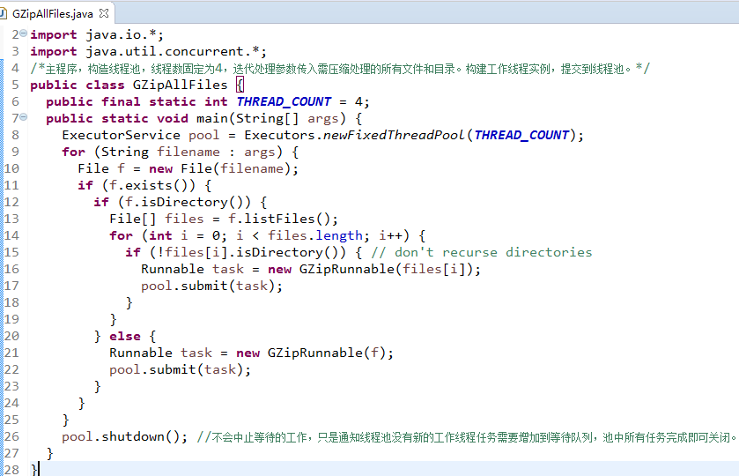
GZipAllFiles.java

Slide 18
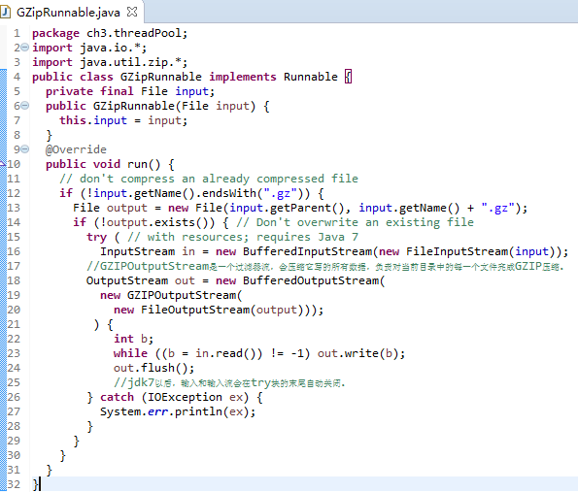
GZipRunnable.java

Slide 19
Using thread pool to implement compressed file programming
Program Structure
Runnable Interface
ExecutorService Interface
Executor Class
run( )
shutdown( )
submit( )
newFixedThreadPool()
Task:Runnable
pool: ExecutorService
GZipRunnable Class
input: File
run( )
GZipAllFiles Class
THREAD_COUNT=4
main( )

Slide 20
Thinking extension:
What classes are there to implement thread pools
Java implements thread pool using factory pattern. What is factory pattern?

Slide 21
Multiple threads accessing the same resource
Resources shared by multiple threads include memory, file handles, sockets , etc.
Multithreading shares resources. If the shared resources are not used at the same time, the program efficiency can be improved.
If shared resources are used simultaneously, they must be shared mutually exclusively. Only one thread is allowed to use them at a time, and the other threads have to wait. Otherwise, the resources will be destroyed and the program may be in chaos.
Shared resources
System.out
Thread 1
Thread 3
Thread 2
Thread 4
At a certain moment, thread 1 accesses, and threads 2 , 3 , and 4 wait.
When programming: You must be able to specify that a shared resource (several statements) can only be accessed exclusively by one thread.

Slide 22
Synchronous block programming technology
Surround
Statements that require exclusive access:
System.out.print( input + “:” );
System.out.print(DatatypeConverter.printHexBinary(digest));
System.out.println() ;
Add a synchronized block:
Synchronized ( System.out ) {
System.out.print( input + “:” );
System.out.print(DatatypeConverter.printHexBinary(digest));
System.out.println() ;
}

Slide 23
Synchronous block programming technology application example
Multithreaded access to log files on a
Multiple threads will use the reference of the LogFile object to obtain the current date and time and write it to the log file. How can I programmatically handle this to avoid confusion?
Connection thread 3 : handles inbound connections
Connection thread 1 : handles inbound connections
Log files
LogFile
Connection thread 4 : handles inbound connections
Connection thread 2 : handles inbound connections
Demonstration sample code ch3- LogFile.java
No synchronization
Three synchronization processing methods

Slide 24
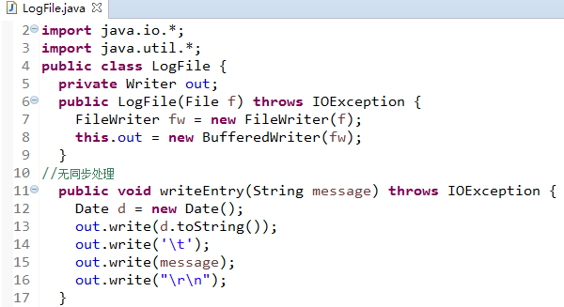
LogFile.java

Slide 25
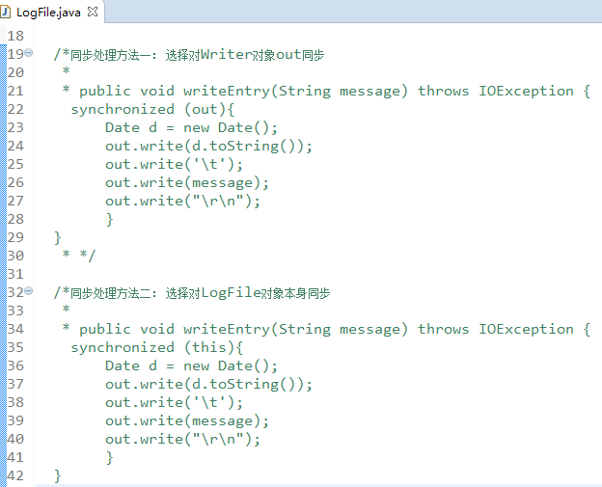
LogFile.java

Slide 26
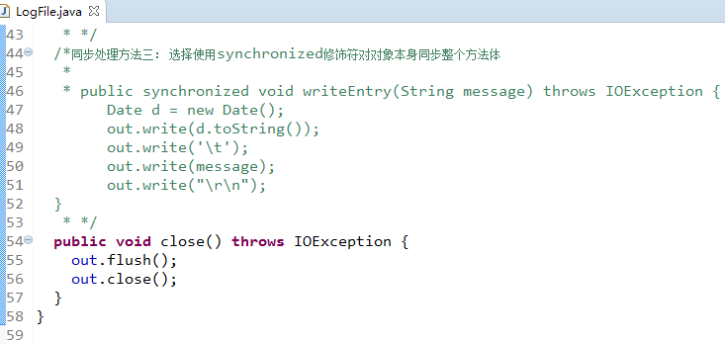
LogFile.java

Slide 27
Programming thinking problem
Improve the file security algorithm summary saving program completed in the last programming thinking problem, and give a file security algorithm summary log generation program.
Requirement: Use multi-threaded synchronous programming technology to save the file security algorithm summary calculated by the file security algorithm summary calculation program (using multi-threaded calculation) into a log file.
For example, the security algorithm summary calculated for the 1.txt file is stored in a log file named SafeLogFile.txt , and the security algorithm summary calculated for the 2.xml file is also stored in a file named SafeLogFile.txt .
And when storing the security algorithm summary of a file in the SafeLogFile.txt log file, the generation time of the security algorithm summary of the file must also be stored.

Slide 28
Problems that may arise from synchronous block programming techniques
1. It may seriously degrade the performance of the VM , reducing the code execution speed by one third or more
2. Greatly increases the possibility of deadlock
3. It is not the object itself that needs to be protected from simultaneous modification or access . If only the instance of the class to which the method belongs is synchronized , it may not protect the object that really needs to be protected .
Connection thread 3 : handles inbound connections
Log files
LogFile
Out object: Writer
Connection thread 1 : handles inbound connections
Connection thread 2 : handles inbound connections
Connection thread 4 : handles inbound connections
Problems caused: The goal is to avoid 4 threads writing to the log file using the out object at the same time, but if other classes have references to out that are completely unrelated to LogFile , these writes will fail.

Slide 29
Replacement technology for synchronous programming technology
Using synchronous programming techniques to solve inconsistency problems that may be caused by thread scheduling will introduce new problems, called synchronization problems.
Think about it: What are some alternative programming techniques that can solve the inconsistency problems that may be caused by multi-threaded resource sharing, and avoid synchronization problems caused by the use of synchronization?
Method 1 : Try to use local variables instead of fields
Method 2 : Basic type method parameters, constructors are usually thread-safe
Method 3 : Use a non-thread-safe class as a private field of a thread-safe class.

Slide 30
Thread Scheduling
Multithreaded programs need to consider thread scheduling issues
Important threads get CPU time to run, more important threads get more time , and can now execute in a reasonable order
Priority : In Java , each thread has a priority, specified as an integer from 0 to 10. The virtual machine schedules the execution of threads with higher priority first . 10 is the highest priority, 0 is the lowest, and the default priority is 5. Usually, the threads in our program are all at the default priority .
Thread.MIN_PRIORITY = 1 , Thread.NORM_PRIORITY = 5, Thread.MAX_PRIORITY = 10

Slide 31
Thread Scheduling
Thread Scheduler : Each virtual machine has a thread scheduler that determines which thread is running at a given time.
Thread scheduling methods : preemptive and cooperative
The preemptive thread scheduler periodically interrupts the currently executing thread and transfers CPU control to another thread.
A cooperative thread scheduler waits for the currently running thread to pause itself before handing control of the CPU to another
When writing a Java thread program to implement the run () method, make sure that the thread has conditions that allow it to be suspended so that other threads have a chance to run.
There are several ways to pause a thread :
on I/O , block on synchronization object, give up, sleep, connect to another thread, wait for an object, end, can be preempted by a higher priority thread, etc.

Slide 32
Questions to think about
1. What is thread deadlock problem
2. What is thread starvation problem
Thread deadlock: Deadlock occurs when two threads need exclusive access to the same set of resources, but each thread has locks on a different subset of these resources.
Thread starvation: When thread scheduling is running, some threads cannot get CPU time slices and are always in a waiting state, unable to run tasks.

Slide 33
Programming problem scenario: Calculate and display the summary of multiple file security algorithms
Thread 1 : File security algorithm summary generation thread
ReturnDigest
getDigest()
Main thread: File security algorithm summary display
getDigest()
Thread 2 : File security algorithm summary generation thread
ReturnDigest
… …
Thread n : File security algorithm digest generation thread
ReturnDigest
getDigest()

Slide 34
Problem continued: Multithreaded programming using accessor methods
Thread Class
ReturnDigestUserInterface Class
run ()
start( )
main( )
dr : ReturnDigest
dr
ReturnDigest Class
filename
digest
There is a problem with using access methods to obtain the output of the calculation thread. The speed of the main() method will exceed the thread that generates the result, and a null pointer exception will occur.
filename: String
digest: byte[]
run( )
getDigest()
start( )
getDigest ()

Slide 35
Problem Solving: Using Connection Threads
Thread 1 : File security algorithm summary generation thread
ReturnDigest
join
Main thread: File security algorithm summary display
join
Thread 2 : File security algorithm summary generation thread
ReturnDigest
join
… …
Thread n : File security algorithm digest generation thread
ReturnDigest

Slide 36
Multithreaded programming using the join thread method
Thread Class
run ()
start( )
join( )
JoinDigestUserInterface Class
main( )
digestThreads
ReturnDigest Class
digestThreads : ReturnDigest [ ]
filename: String
digest: byte[]
start( )
join( )
getDigest ()
run( )
getDigest()
Code example demonstration and operation: ch3.JoinDigestUserInterface.java, ex3-12
Compare and run ch3.returnInfo.ReturnDigestUserInterface.java

Slide 37
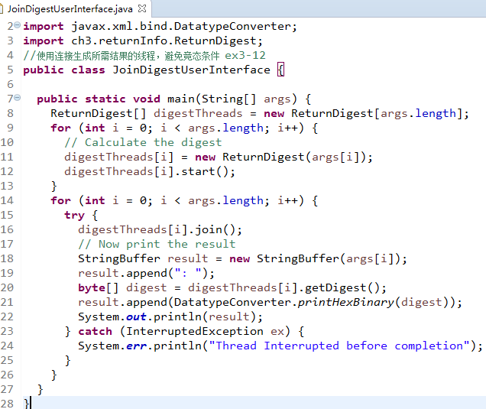
JoinDigestUserInterface.java

Slide 38
Connecting thread programming techniques
Allows a thread to wait for another thread to complete before continuing execution
calls the join() method is the joining thread ( join thread) , waiting for the thread to be connected (joined thread) ( the join method belongs to the connected thread).
Question: In the above ex3-12 program design, which one is the connecting thread? Which one is the connected thread?

Slide 39
Connecting thread programming techniques
By calling the join() method, a thread is allowed to wait for another thread to finish before continuing . How long should the joining thread wait?
Depends on the join() parameter:
join() ---- infinitely wait for the connected thread to end
join( long milliseconds )---- Wait for milliseconds microseconds and then continue execution.
join ( long milliseconds, int nanoseconds ) --- Wait for nanoseconds milliseconds or milliseconds microseconds before continuing

Slide 40
Thanks

